Slide 1

Forging new generations of engineers

Slide 2
Research and Development

Slide 3
Terminology
Research – refers to the advancement of knowledge
Development – refers to the application of knowledge
Market Research – refers to the process of gathering, recording, and analyzing data about consumer needs and wants and the products, processes, and services they use
Notes:
Definitions:
Research: The systematic study of materials and sources in order to establish facts and reach new conclusions.
Development: To change the form of something through a succession of states or stages, each of which is preparatory to the next. The successive changes are undertaken to improve the quality of or refine the resulting object or software.
Market Research: The activity of gathering information about consumers’ needs and preferences.

Slide 4
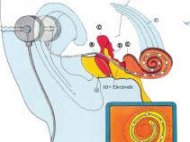
Research and Development
Research and Development: Also called R&D is the practical application of scientific and engineering knowledge for discovering new knowledge about products, processes, and services, and then applying that knowledge to create new and improved products, processes, and services that fill market needs.
Image Above: The cochlear implant, pioneered by NASA engineer Adam Kissiah, selects speech signal information, then sends electrical pulses to the patient's ear. Photo Credit: NASA Spinoff 2003

Slide 5
Purpose
Conducted by specialized centers
  Universities
  State Agencies
  Companies
Advances in scientific and technological development and commerce are made possible with R&D
2006 – Three largest spenders on R&D
  United States -- $330 billion
  China -- $136 billion
  Japan -- $130 billion

Slide 6
Invention vs. Innovation
Invention: A new product, system, or process that has never existed before, created by study and experimentation.
Innovation: An improvement of an existing technological product, system, or method of doing something.
Notes:
RTK AutoSteer helps farmers reduce fuel costs, decrease driver fatigue, and eliminate overlap. Pictured here are GPS system antennas roof-mounted on a farming tractor and the touch screen controls for the GPS guidance system installed in the cockpit.

Slide 7
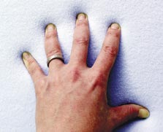

Invention vs. Innovation
Initially referred to as “slow spring back foam,” temper foam matches any pressure against it and slowly returns to its original form once the pressure is removed. Photos NASA Spinoffs.

Slide 8
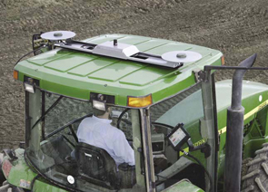
Invention vs. Innovation
RTK AutoSteer helps farmers reduce fuel costs, decrease driver fatigue, and eliminate overlap. Pictured here are GPS system antennas roof-mounted on a farming tractor and the touch screen controls for the GPS guidance system installed in the cockpit. Photo: NASA Spinoffs

Slide 9
Market Research
Purpose – help companies make better decisions, create a business plan, launce a new product or service, fine tune existing products and services, or expand into new markets.
What information is needed in order to solve the problem?
Basic Steps –
  Define the research problem
  Select and establish research design
  Collect and analyze data
  Make Decisions
Notes:
A list of questions that can be answered through market research are:
What information is needed in order to solve the problem?
What is happening in the market?
What are the trends? Who are the competitors?
How do consumers talk about the products in the market? What do they want to see? What do they like or dislike?
Which needs are most important? Are the needs being met by current products?

Slide 10
